Slide 1

Mastering Graph Traversal: BFS vs. DFS
Presented by Muhammad Asad and Muhammad Mohid

Slide 2

What is Graph Traversal?
Graph traversal is the process of visiting every node (vertex) in a graph exactly once, systematically. It's fundamental for understanding graph structures and powers many essential algorithms.
Finding Paths
Checking Connectivity
Solving Puzzles
Discovering connections and routes within complex networks.
Determining if all parts of a system are linked.
Navigating state spaces in games and logical challenges.
At its core, all traversal methods rely on a Visited Set to prevent endless loops and redundant processing.

Slide 3

Breadth-First Search (BFS): Explore Broadly
BFS is a level-order traversal, exploring all neighbors at the current depth before moving to the next level. Think of it like ripples expanding in water.
Core Idea
Explores layer by layer, visiting all nodes at depth k before any nodes at depth k+1.
Key Data Structure
A Queue (First-In, First-Out) is crucial, ensuring nodes are processed in the order they were discovered.
This systematic approach guarantees the shortest path in unweighted graphs.

Slide 4

BFS Algorithm & Application
The BFS algorithm systematically explores the graph. Here's a quick overview:
01
02
03
Initialize
Enqueue Start Node
Loop While Queue Not Empty
Queue and Visited set.
Mark it as visited.
Dequeue current node, process it, then enqueue and mark all its unvisited neighbors.
The time complexity is O(V + E) and space complexity is O(V).
Manual Trace Example (Start: A)
Key Applications
Step
Current Node
Queue
Visited Set
Shortest Path in Unweighted Graphs (e.g., 8-Puzzle)
Web Crawlers
0
-
[A]
{A}
Peer-to-Peer Networking
1
A
[B, C]
{A, B, C}
2
B
[C, D, E]
{A, B, C, D, E}

Slide 5

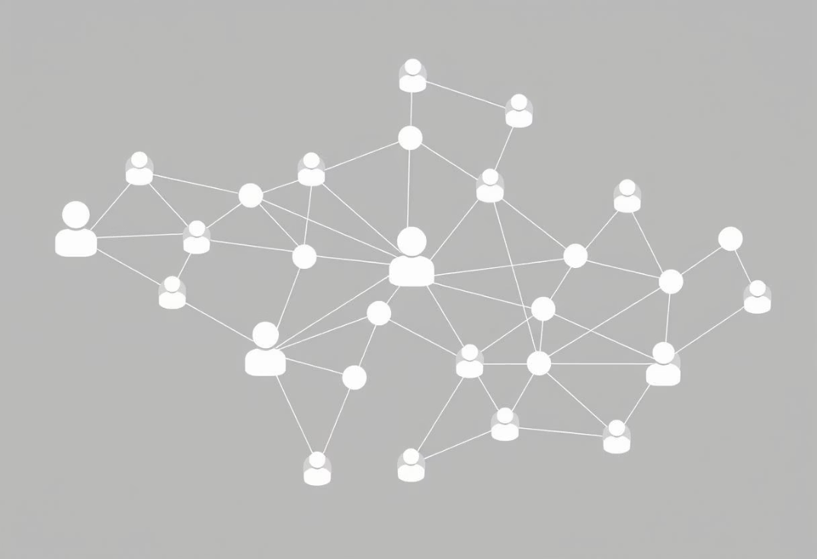

BFS Examples from Literature
Breadth-First Search (BFS) is a versatile algorithm with numerous applications. Here are some classic examples:
1
2
3
Social Network Friend Suggestions
Web Crawler Implementation
Shortest Path in Unweighted Maze
Source: "Algorithms, 4th Edition" by Robert Sedgewick and Kevin Wayne
Source: "Introduction to Algorithms" by Thomas H. Cormen, Charles E. Leiserson, and Ronald L. Rivest
Source: "Algorithms, 4th Edition" by Robert Sedgewick and Kevin Wayne
Finding the shortest connection path between two people in a social network. BFS explores friends level by level - first direct friends (distance 1), then friends-of-friends (distance 2), and so on, guaranteeing the shortest chain of connections.
Web crawlers use BFS to systematically explore websites. Starting from a seed URL, the crawler visits all pages at the current depth before moving to links found on those pages, ensuring comprehensive coverage without getting lost in deep link chains.
Finding the shortest route through a maze where each cell is a node and adjacent cells are connected by edges. BFS guarantees finding the path with the minimum number of steps from start to exit.
These examples demonstrate BFS's strength in finding shortest paths and level-order exploration.

Slide 6

Depth-First Search (DFS): Dive Deep
DFS explores as far as possible along each branch before backtracking. It's like navigating a maze, following one path to its end.
Core Idea
Prioritizes depth, exploring one path fully before considering alternative branches.
Key Data Structure
A Stack (Last-In, First-Out) or Recursion is used, enabling the deep dive and eventual backtracking.

Slide 7
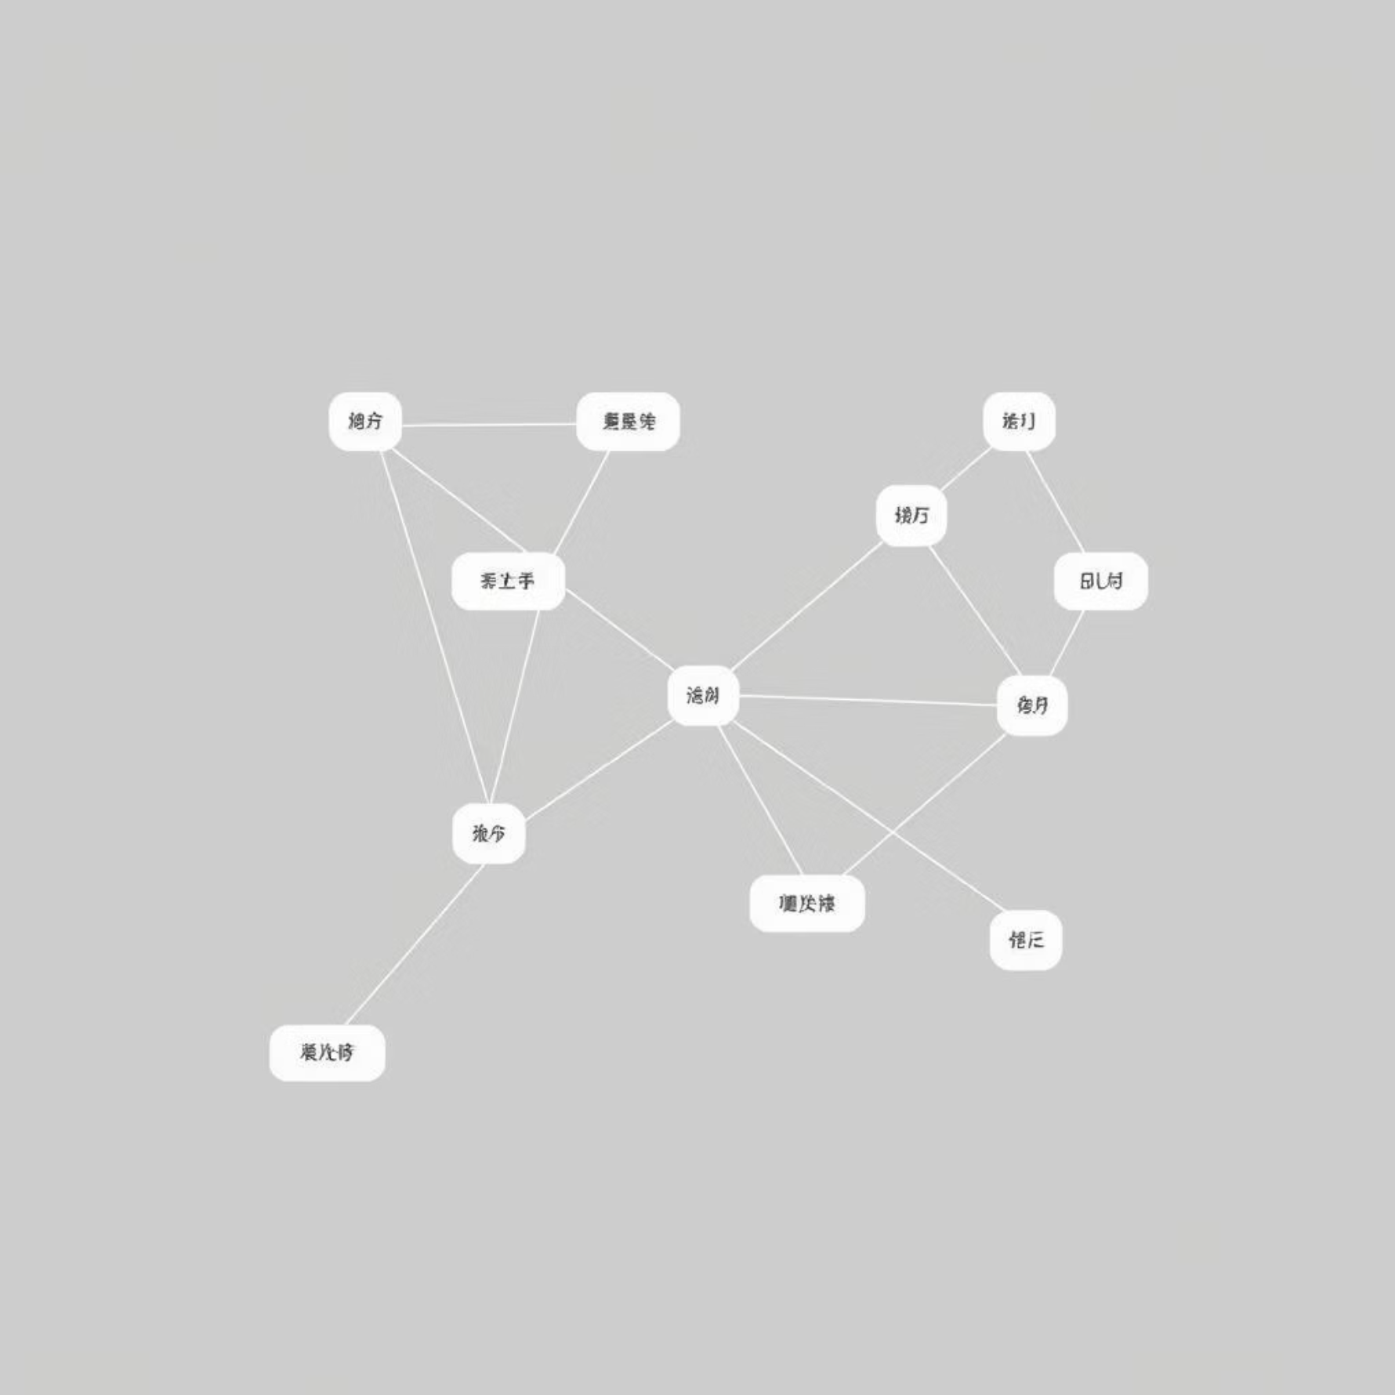
DFS Algorithm & Application
The DFS algorithm is ideal for problems that require exploring every possible path.
01
02
03
Initialize
Push Start Node
Loop While Stack Not Empty
Stack (or recursion) and Visited set.
Mark it as visited.
Pop current node, process it, then push and mark all its unvisited neighbors (often in reverse order for consistent traversal).
The time complexity is O(V + E) and space complexity is O(V).
Manual Trace Example (Start: A)
Key Applications
Step
Current Node
Stack
Visited Set
Cycle Detection
Topological Sorting (e.g., project dependencies)
0
-
[A]
{A}
Solving Mazes/Puzzles (backtracking)
1
A
[C, B]
{A, B, C}
Finding Connected Components
2
B
[C, E, D]
{A, B, C, D, E}

Slide 8
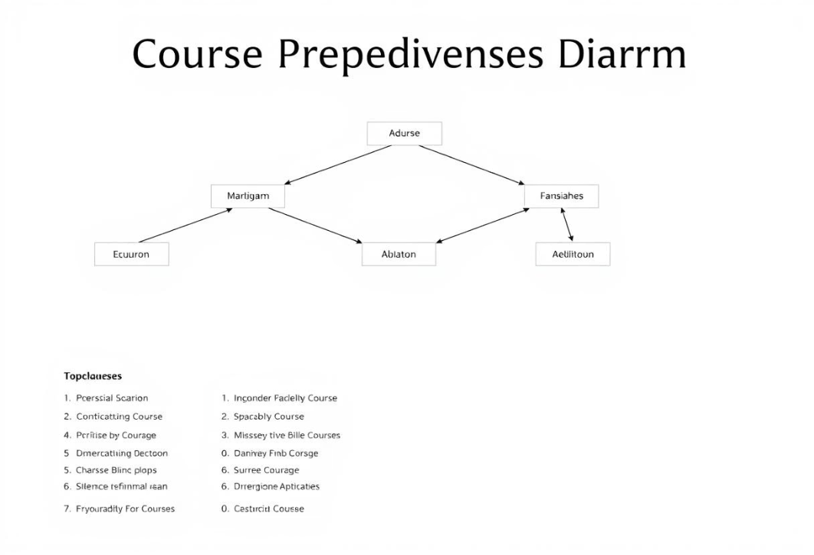

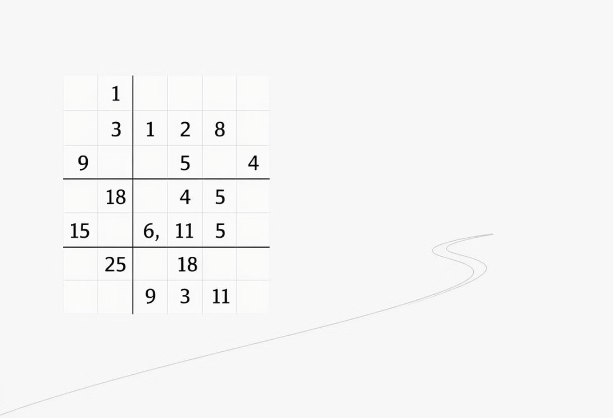
DFS Examples from Literature
1
2
3
Topological Sorting for Course Prerequisites
Detecting Cycles in Dependency Graphs
Solving Sudoku Puzzles with Backtracking
Source: "Introduction to Algorithms" by Thomas H. Cormen, Charles E. Leiserson, and Ronald L. Rivest
Source: "Algorithms, 4th Edition" by Robert Sedgewick and Kevin Wayne
Source: "Introduction to Algorithms" by Thomas H. Cormen, Charles E. Leiserson, and Ronald L. Rivest
Universities use DFS to determine valid course orderings based on prerequisites. DFS explores each course's dependency chain completely before backtracking, producing a topological order where all prerequisites come before dependent courses.
Software build systems use DFS to detect circular dependencies. By tracking visited nodes and the current recursion stack, DFS can identify back edges that indicate cycles, preventing infinite loops in dependency resolution.
DFS with backtracking explores possible number placements in Sudoku. It tries a number, recursively solves the rest, and backtracks if it reaches an invalid state. This deep exploration with backtracking is ideal for constraint satisfaction problems.
These examples highlight DFS's effectiveness in problems requiring complete path exploration and backtracking.

Slide 9
BFS vs. DFS: A Side-by-Side Comparison
Understanding their differences is key to choosing the right algorithm.
Feature
Breadth-First Search (BFS)
Depth-First Search (DFS)
Traversal
Level-by-Level (Broad)
Path-by-Path (Deep)
Core Structure
Queue (FIFO)
Stack (LIFO) or Recursion
Shortest Path?
Yes (in unweighted graphs)
No (unless modified)
Memory Use
Can be high (stores an entire level)
Can be low (stores only current path)
Time Complexity
O(V + E)
O(V + E)
Both algorithms share the same asymptotic time complexity, but their underlying mechanisms lead to different behaviors and optimal use cases.

Slide 10


When to Use Which Algorithm?
Selecting between BFS and DFS depends on the specific problem constraints and objectives.
Use BFS When:
Use DFS When:
Finding the Shortest Path: Especially in unweighted graphs, as BFS naturally finds the path with the fewest edges.
Memory is a Concern: As it only stores the current path, it's more memory-efficient for deep graphs.
Target Node is Shallow: If the goal node is likely to be close to the start node, BFS will find it faster.
Exploring All Paths/Backtracking: Ideal for problems like maze solving, puzzles, or finding all possible solutions.
Level-Order Traversal: When you need to process nodes in increasing order of their distance from the source.
Target Node is Deep: If the goal is likely far from the start, DFS might find it quicker by diving deep.

Slide 11
Thank You

